Slide 1
Multi-Label Genre Classification on IMDb Dataset
Kamran Mehboob

Slide 2
Problem Statement:
Given an IMDB dataset, predict movie genre/genres
The dataset is downloaded from https://cometa.ujaen.es/datasets/imdb. It contains various columns/features related to movies, such as title, release year, genre, plot, IMDb ratings, runtime, etc. The target variable for our problem is the 'genre' column, which lists the different genres a movie belongs to.
The platform used for solving this assignment was google colab.

Slide 3
Flow Diagram followed in the notebook
Data Loading & Preprocessing
Splitting Data into train & test
Model Evaluation
Auto ML
Test Data Evaluation

Slide 4
Data Loading & Preprocessing
We load our imdb data into a dataframe in python.
We perform EDA on our dataset to gain insights of our data. We check the total number of labels present in our dataset (44 here). The average word count present.
We tokenize our feature column “plot_long” and use this column to predict the different genres our movie belongs to.
The tokenization step involves computing the input_ids and attention_mask given our tokenized plot_long feature column.
We remove rest of the features from our dataset as they are not needed in our model training.

Slide 5
Splitting data into Train & Test
After preprocessing the data-frame the next step is to do model training.
We use the split of 75-25 for our model training, meaning that 75% of our data will be used for training and 25% will be used for testing purpose.
Since our data-frame has a total of 30,042 number of data samples, nearly 22531 will be used in training ( and validation) while the remaining 2511 data-points will be used for testing

Slide 6
Auto ML
AutoML, or Automated Machine Learning, is a technology designed to automate the end-to-end process of applying machine learning to real-world problems.
AutoML streamlines the machine learning process by automating tasks such as data preprocessing, feature selection, model selection, hyperparameter tuning, and model evaluation, making it accessible to non-experts.
In our problem statement we would like to automate the process of hyperparameter selection
The framework used in our project for hyperparameter selection is optuna.

Slide 7
Contd..
"The different hyperparameters passed to Optuna to configure were learning_rate, weight_decay, num_train_epochs etc.,
We learn the best parameters by training our BERT model on each of the different combinations and checking which combination yields the lowest training and validation loss.
For our problem statement the best hyperparameter learned values were:-' learning_rate': 1.2396871191869623e-05, 'per_device_train_batch_size': 32, 'num_train_epochs': 4, 'weight_decay': 0.22045660555177576, 'warmup_steps': 16.

Slide 8
Model Evaluation
The next step involves training our model on the learned hyperparameters
We log the training and validation loss for each epoch to validate whether our model is not overfitting ( or underfitting).
Overfitting scenario occurs when our model, instead of learning from the data memorizes it. Underfitting occurs when our model simply learns nothing from our data.
The training and validation loss on our data suggests that our model is working perfectly i.e neither overfits nor underfits.

Slide 9
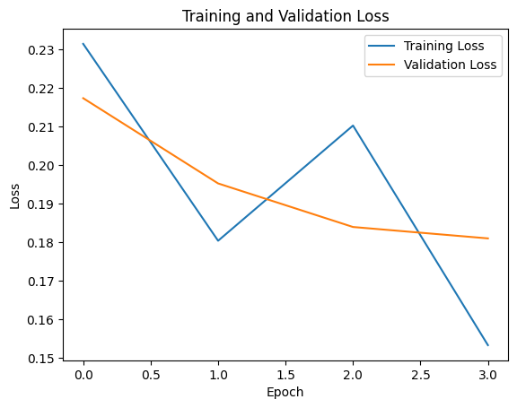

Slide 10
Test Data Evaluation
After training our model, we test our model on some random samples of test-data.
We randomly sample 5 data-points from our test data and check for model’s predictions on them.
For better precision and accuracy, it is advised that the model be trained for more epochs and on a high-performance computing device

